Slide 1


USER INTERFACE TESTING
Rosemary Medina-Casanova | Gian Villafañe | Maya Wilson-Fernandez

Slide 2
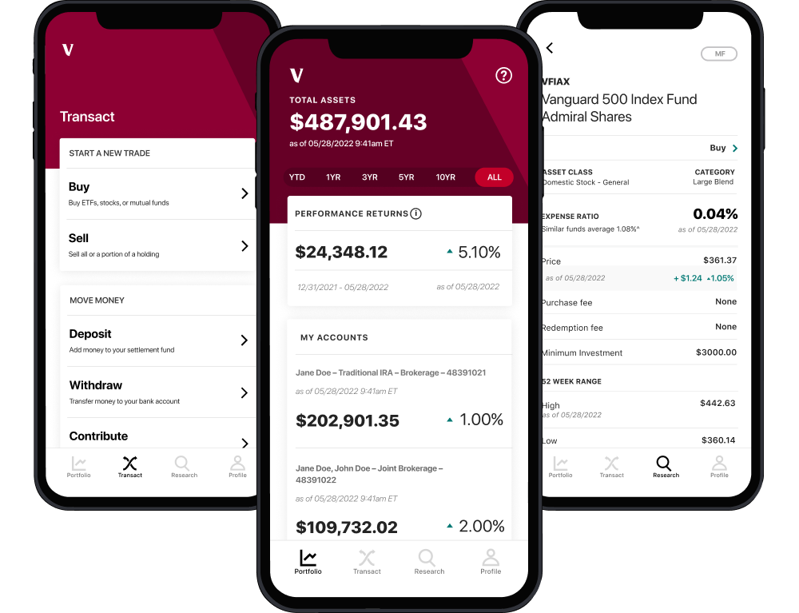
Introduction
Vanguard is one of the largest investment companies in the world.
We are analyzing the results of A/B Testing carried out in 2017, in order to determine the performance of a potential new User Interface and answer the following question:
Did the new User Interface (UI) lead to higher completion rates?

Slide 3
DATA OVERVIEW
We had three data sets to work from:
Client Profiles
Digital Footprints
Experiment Roster
This dataset gave us a detailed view of our client demographics, covering age, gender, tenure and account balances.
This dataset provided us with the process steps and visitor IDs essential in finding key performance indicators (KPIs) and understanding how the client pool engaged with the environments.
This dataset furnishes us with critical data points distinguishing whether a client was placed in the Test or Control environment.

Slide 4
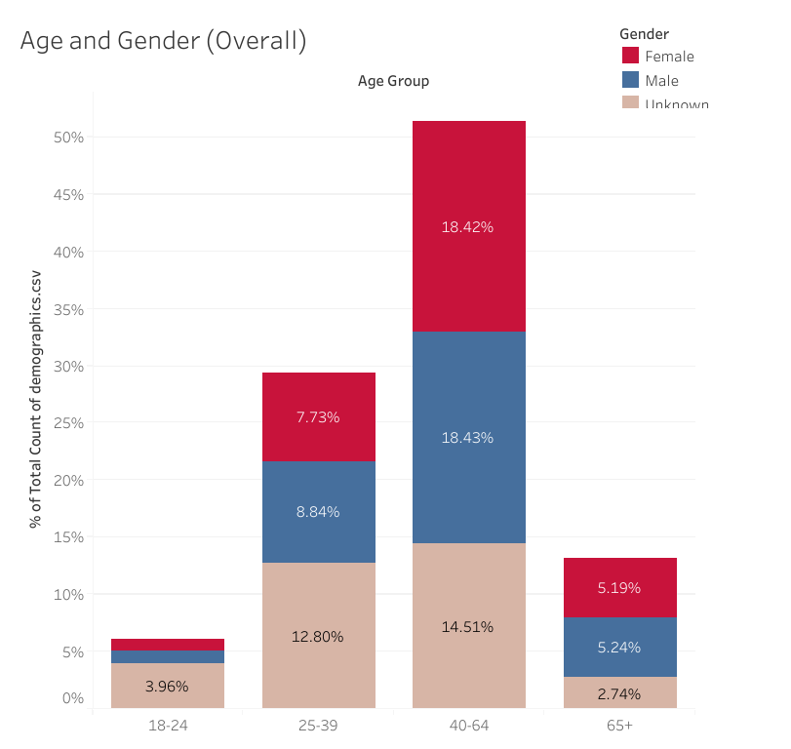
EXPLORATORY DATA ANALYSIS - GENDER
The most populous age group is 40-64, making up approximately 41.36% of the total demographic.
The least populous age group is 18-24, contributing only 3.96% to the total demographic.
Males generally outnumber females in younger age groups, particularly noticeable in the 18-24 and 25-39 groups.
Given the dominance of the 40-64 age group, stakeholders might consider tailored products or services to meet the needs of this demographic.

Slide 5
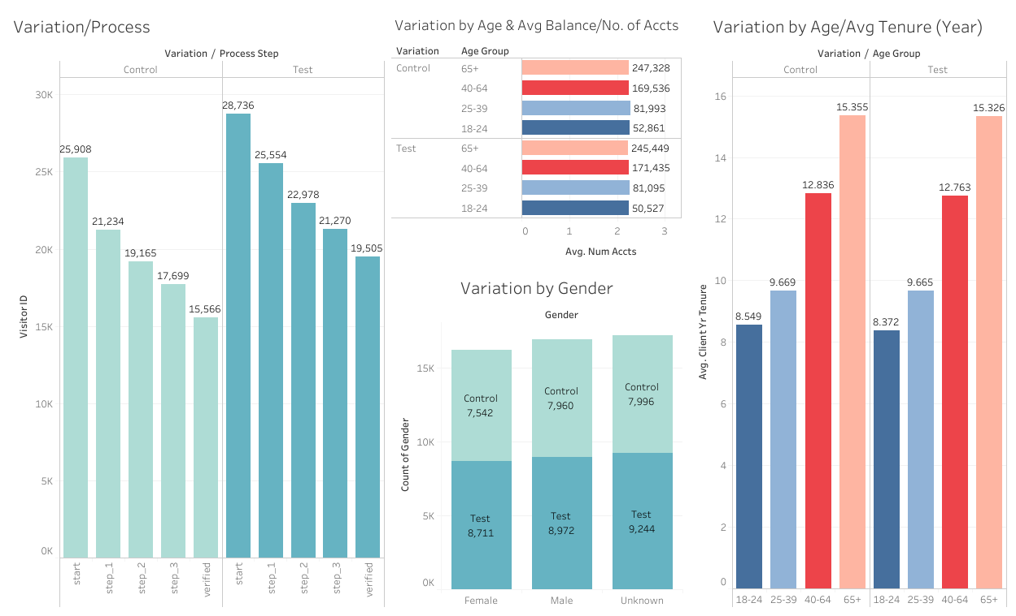
EXPLORATORY DATA ANALYSIS - VARIATION
The visuals above dissect demographic data by environment. While the Test environment began and ended with more clients, both environments showed relatively even distribution. This observation suggests a balanced representation across the board.

Slide 6
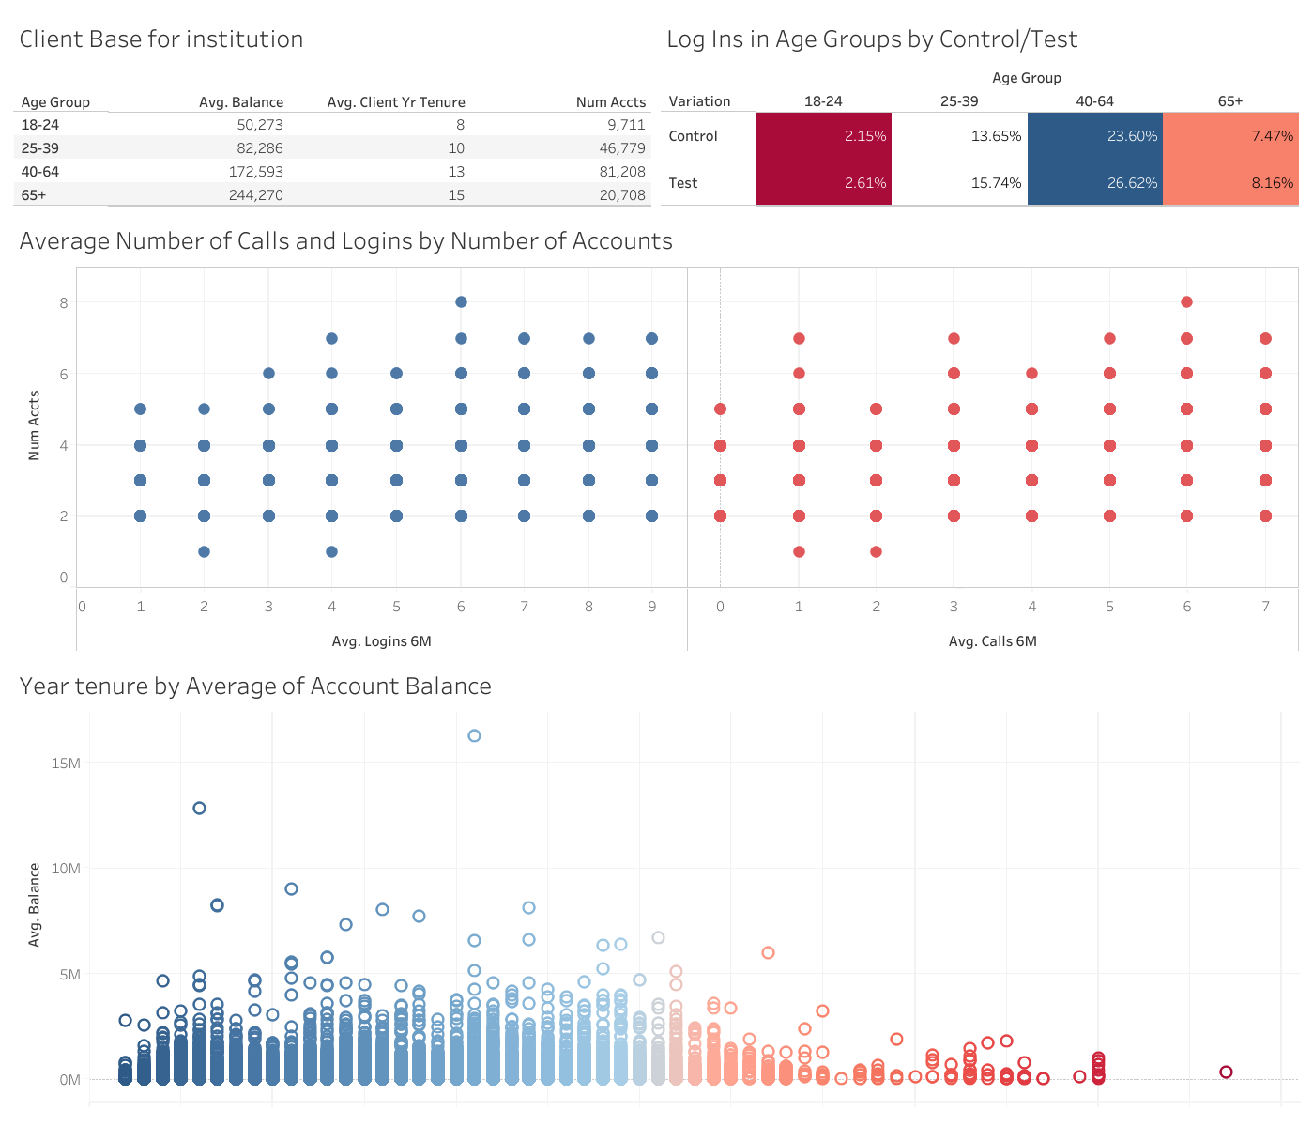
KEY CLIENT SEGMENT: 40 - 64 YEARS OLD
Based on the client base dashboard:
This demographic also holds the highest number of accounts, with an average balance of $172,000.
Additionally, this older age group recorded the most logins over a six-month period, with rates of 23% and 26% in both the test and control groups, respectively.
There's a clear trend that clients with more accounts tend to log in and call more frequently. Those with 9 accounts log in the most, while those with fewer accounts have fewer logins and calls.
Clients with longer tenure tend to have higher average balances, which could indicate successful financial growth or accumulation over time.

Slide 7
KEY PERFORMANCE INDICATORS
Completion Rate
Bounce Rate
How many clients completed the entire process (to the verify step).
How many clients went back and forth between steps (ie. from Step One to Start).
Average Duration per Step
Error Rate
Average amount of time test subjects spent on a step and the whole process.
How many clients gave up on the process (from any of the steps).

Slide 8
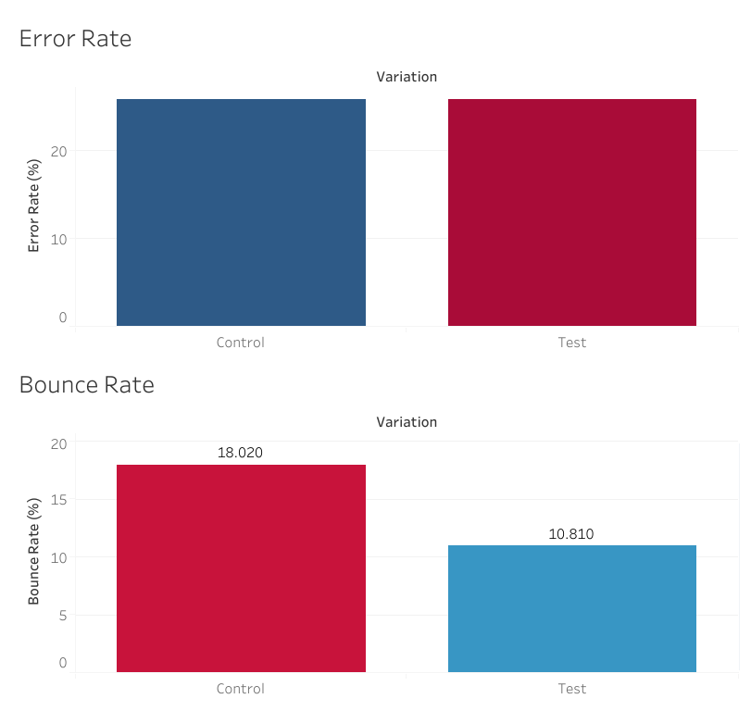
KPI VISUALIZATIONS
25.7% / 25.9%
18.02% / 10.81%
Error Rates for Control/Test Subjects
Bounce rates for Control/Test Subjects

Slide 9
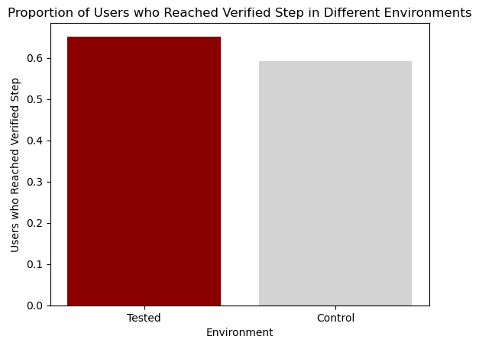
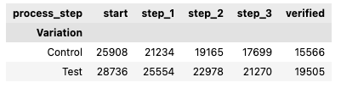
HYPOTHESIS TESTING
Tests for completion rate differences and cost-effectiveness threshold evaluation
Based on the results on the completion rates and increase in completion rate - we would recommend that Vanguard moves forward with upgrading its UI. Our analysis observed a 10% increase in the completion rate from the A/B test, which exceeds the 5% threshold Vanguard set forth. We can also confirm the difference is statistically significant. In conclusion, the costs associated to the redesign are justifiable.

Slide 10
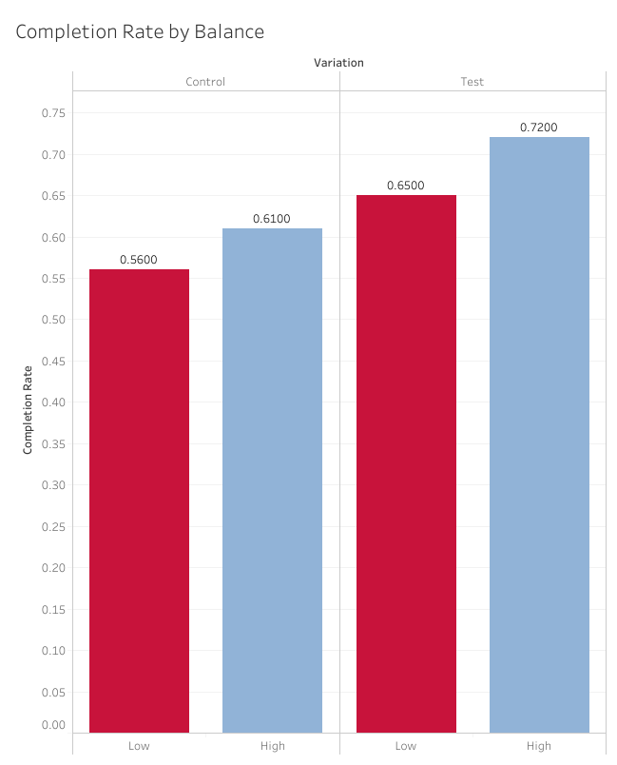
HYPOTHESIS TESTING
Tests for correlation between completion rate and account balances
Hypotheses:
Null - There is little difference in completion rate based on high or low account balance.
Alternate - High balance users are more likely to complete all the steps in the process.
Results:
Chi-squared Statistic: 0.137089501753
P-value: 0.7111917584999944
Based on these results, we do not reject the null hypothesis.

Slide 11
KEY CHALLENGES & LEARNINGS
We found managing a GitHub repository challenging, especially the aspects of conflict resolution and consistent version control among multiple collaborators.
Creating a new dataframe for KPI visualization in Tableau was difficult due to the need for precise data manipulation and ensuring the data accurately reflected the intended metrics.
The learning curve with Tableau was steep, as mastering its extensive tools and features required for advanced visualizations and effective data presentations took significant time and effort.
We encountered a last minute issue in our calculations - we had initially based them on Client ID, rather than Visitor ID.

Slide 12
CONCLUSION
Key Findings:
The updated User Interface was ultimately successful in terms of completion rate and cost-effectiveness threshold evaluation.
Recommendations for Vanguard:
Due to the preceding information, we recommend Vanguard make sure that further design choices be centered around the needs of the dominant age group (40-64).
In addition, the difference in proportions amongst age groups suggests that Vanguard should look to the future and create initiatives that attract and retain a younger clientele. These can look like:
Partnerships with youth financial literacy programs
Offers for college or young people such as matching their first $100 investment.
Blend sleek design with advanced AI to empower young, digitally-focused clients in understanding and optimizing their investments.
Personalized investment amounts based on individual goals, creating a seamless, intuitive experience for modern wealth management.

